Slide 1

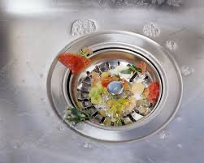
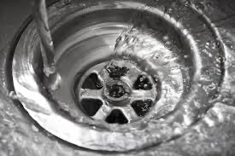

Common Issues with Food Disposal:
Removing food waste from the sink bowl is often a low priority in busy settings.
Plug covers or capture trays are frequently:
Missing entirely
Rinsed out—allowing food waste to go straight down the drain
Emptied directly into food recycling without proper separation

Slide 2
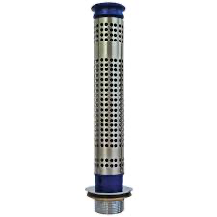
Current ‘Solutions’ not doing the job?
The Problem with Current Solutions
Commercial kitchens commonly use a basic "stand-pipe strainer" to manage food waste.
The stand-pipe plugs the sink drain, holding food waste on the surface.
Intended use: Remove the center insert to drain water while keeping waste in the sink.
Actual use: Entire pipe is often pulled out, allowing food waste to go down the drain.
Staff may even manually push waste down the plughole, using unsanitary methods.
This behavior leads to frequent blockages and costly professional drain callouts.

Slide 3
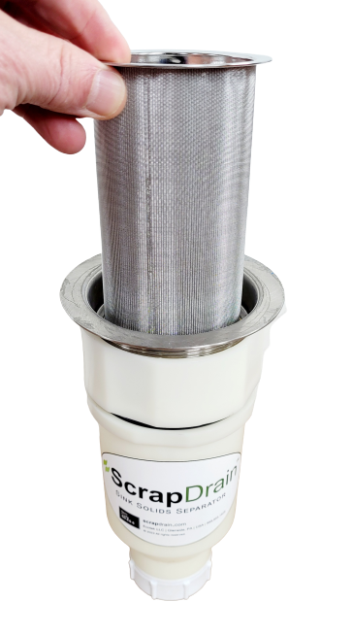
Why ScrapDrain?
When we designed ScrapDrain, we accepted how people clean the sink down.
Making ScrapDrain part of the plumbing, (under the sink), with the integral basket accessible from the top, everything sent to drain is captured.
The user can clean the sink the way they would normally do and ScrapDrain does the rest.

Slide 4
The Benefits of ScrapDrain
Prevents Drain Clogs: Effectively intercepts food solids, coffee grounds, and other debris before they reach drain lines—reducing blockages and plumbing issues.
Improves Grease Trap Efficiency (Commercial Kitchens): By limiting solid waste, grease traps function better and may require less frequent cleaning—saving time and costs.
Optimisd for Coffee Shops: The fine mesh basket (SD-50-F) is ideal for capturing small items like grounds and straws, keeping sink areas clean and functional.
Supports Composting (Residential Use): Streamlines food waste separation for composting, especially in homes without garbage disposals or with curbside organic recycling programs.

Slide 5
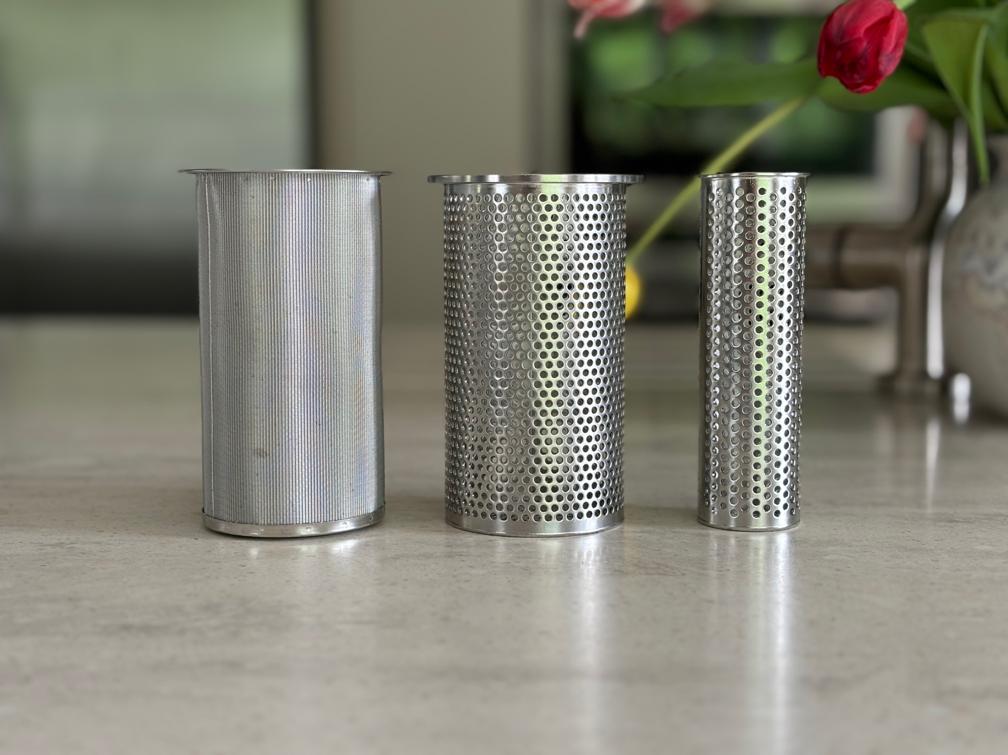
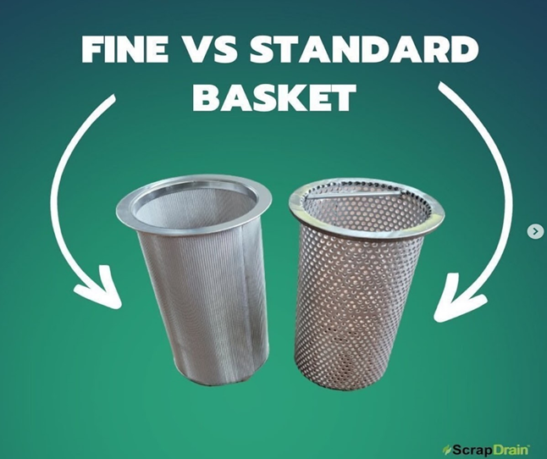
ScrapDrain Options
ScrapDrain baskets are available in two sizes: 89mm or 40ml.
You can choose between a ‘fine’ or ‘standard’ internal basket option.
The standard strainer filter, with 2.5mm holes, is suitable for general use.
The fine strainer filter is designed to capture smaller particles like coffee grounds and seeds and is ideal for grease-free applications. However, it may become clogged when exposed to fats, oils, or grease.

Slide 6
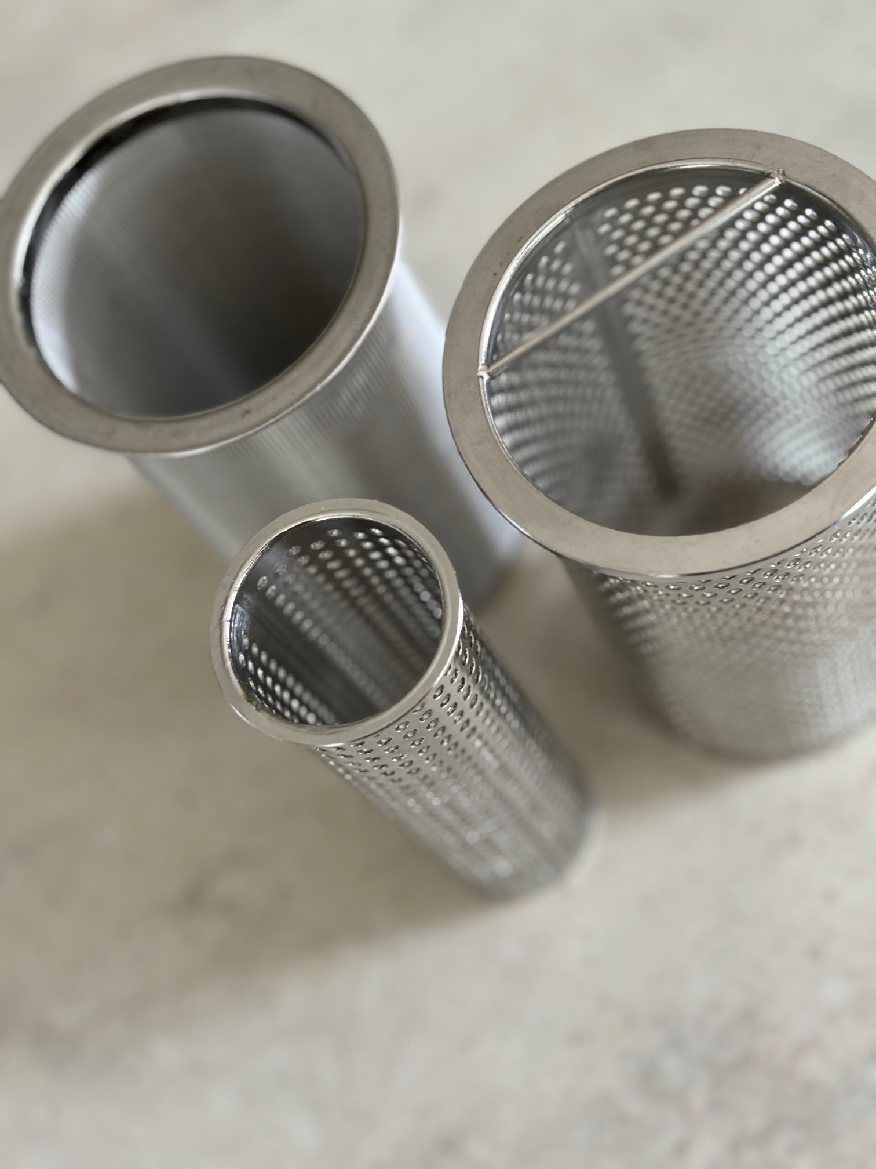
ScrapDrain Options Cont’d…
Domestic sinks typically use 89mm waste outlets.
Commercial sinks usually have 40mm outlets, but these can be upgraded to 89mm when ordering new sink bowls.
Whenever possible, 89mm outlets are recommended to maximise the capture of food waste.

Slide 7
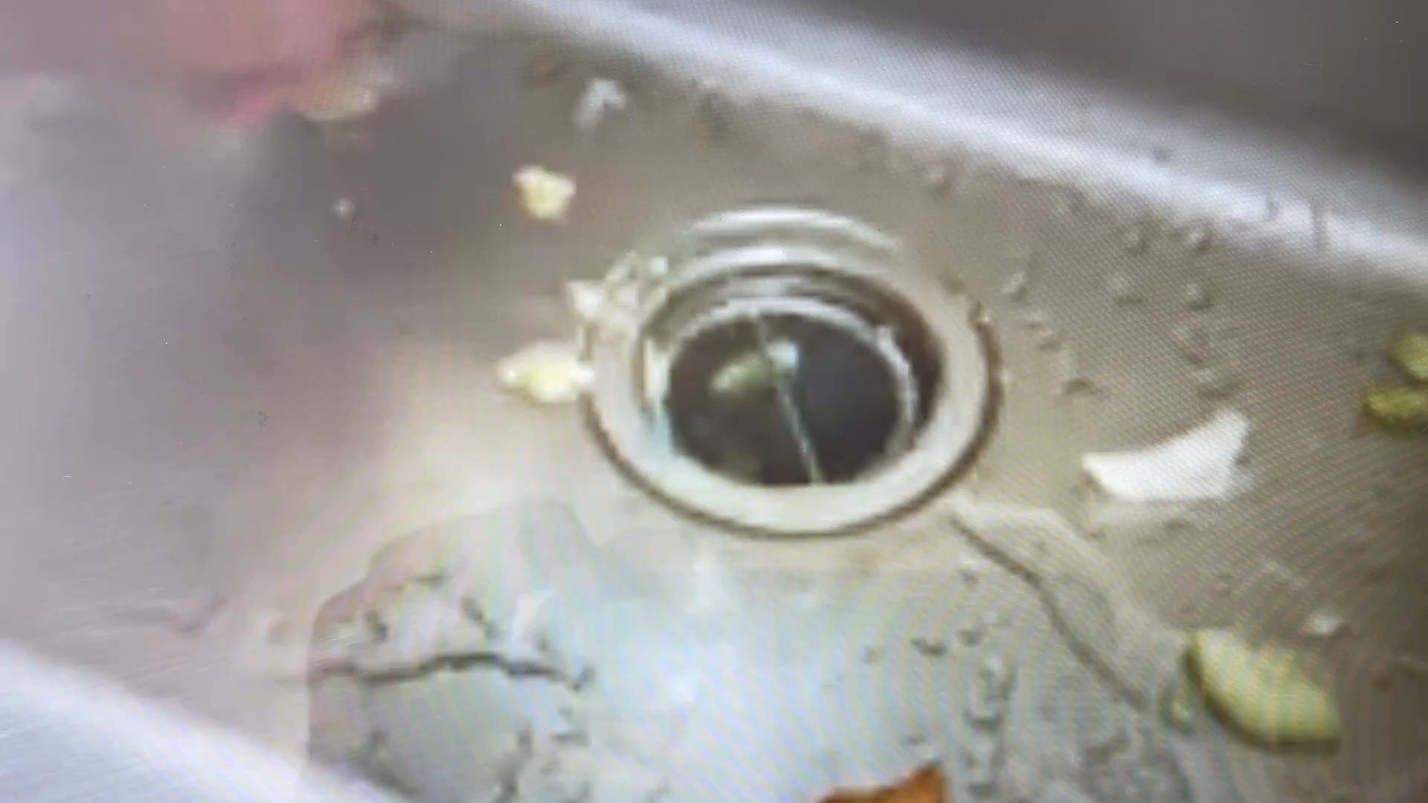
ScrapDrain Demonstration
Actually, removing food waste & particulates from our drain lines

